Slide 1
Banking Campaign predictive Analytics
Haveeshya Kandhiraju

Slide 2
INTRODUCTION
Banking has seen a lot of advancement in technology and application of ML algorithms.
One such application is Predictive analytics.
As part of this project, I am using predictive analytics to determine the likelihood of a Banking user signing up for a specific Banking campaign.
The product in focus is the Banking term deposit.
This predictive analysis will enable the Banks to focus on specific customers thus saving time and Money for the banks and increasing the efficiency of the campaign.

Slide 3
DATASET
For this project we have used the dataset from the the UCI website.
The data is related to the marketing campaign of the Bank.
The dataset contains 45211 records with 17 different variables.
The dataset consists of fields like Age, Job, Marital, Education, Balance, Housing, Loan, Contact, Month, Day, Target (desired target) etc.

Slide 4
TOOLS AND TECHNOLOGY
Python
Pandas
NumPy
Scikit-Learn
Machine Learning Models
Gaussian Naïve Bayes
Decision Tree
XgBoost (Extreme Gradient Boost)
AWS
Simple Storage Service(S3)
Identity and Access Management(IAM)
Sagemaker

Slide 5
PROJECT FLOW
Platform Setup
Data Loading
Data Preprocessing
Data Visualization
Feature Engineering
Model Training
Model Prediction
ROC and AUC Curve
Confusion Matrix
Classification Report
Accuracy Comparison

Slide 6
PLATFORM SETUP (AWS)
We built our project in the Amazon Web Services Cloud.
To run our ML algorithms in the cloud we performed the following setup:
Create an IAM Role to provide the required access and permissions.
Setup AWS S3 Bucket and upload the dataset.
Setup the Sagemaker domain and create a user.
Start the Sagemaker Studio and execute the jobs.

Slide 7
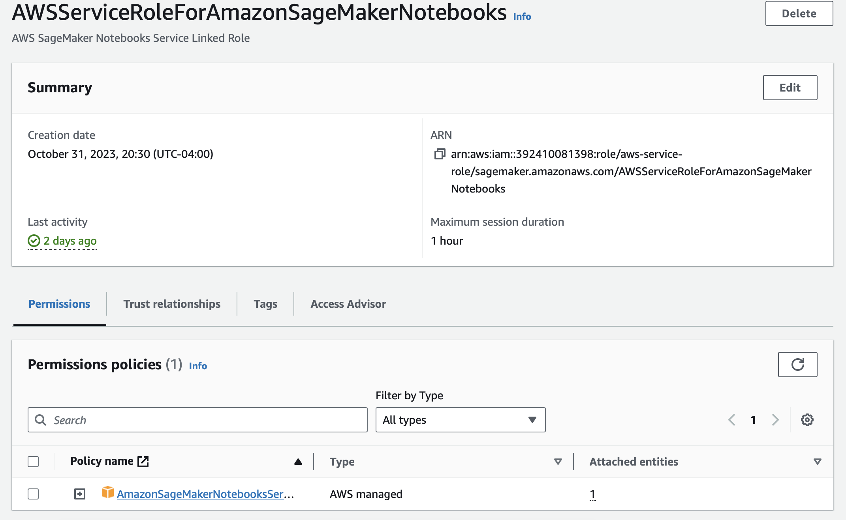
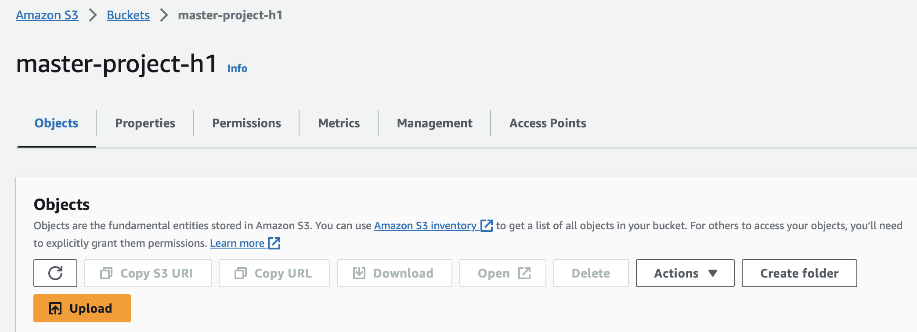
IAM Role & S3 Bucket
Creating an IAM Role to provide the required access and permissions.
Setting up AWS S3 Bucket to upload the dataset for loading the data.

Slide 8
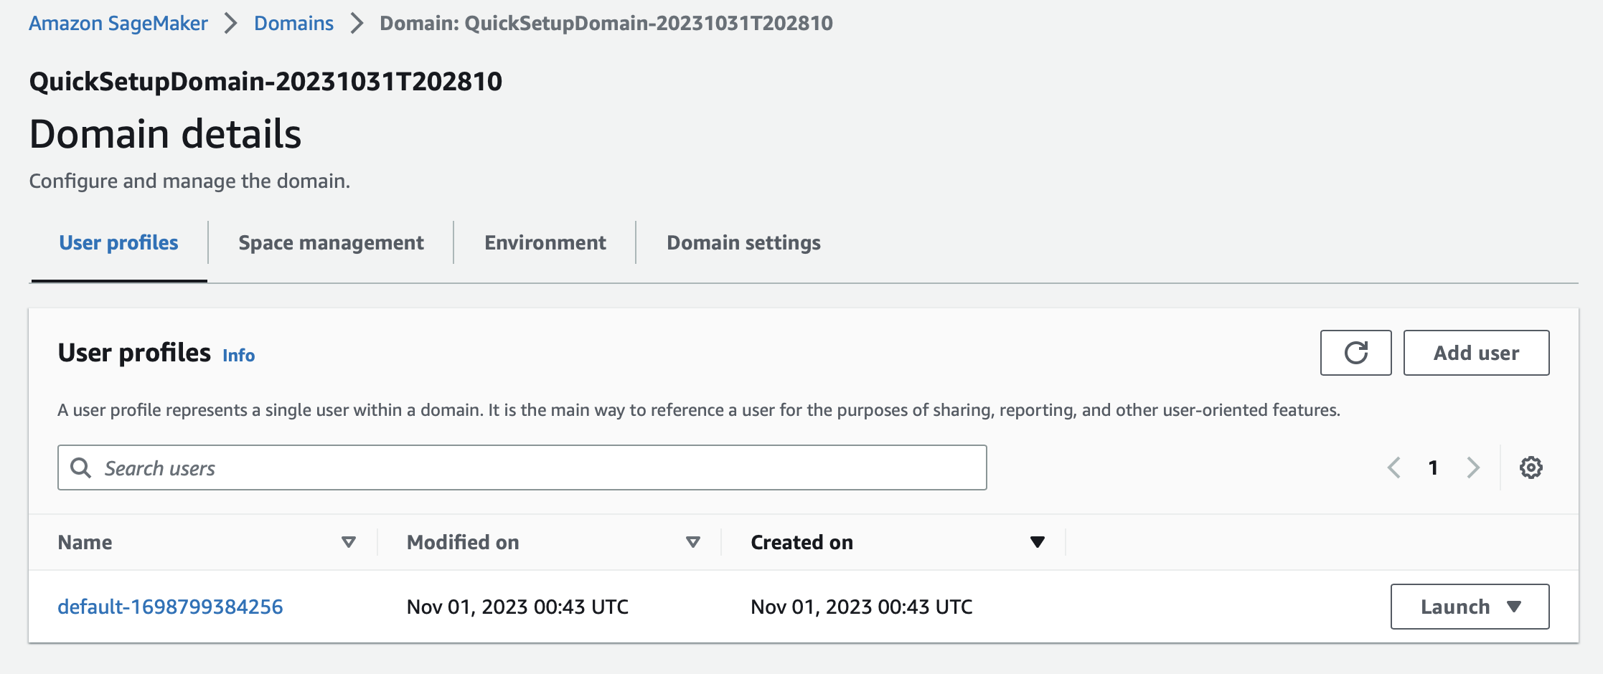
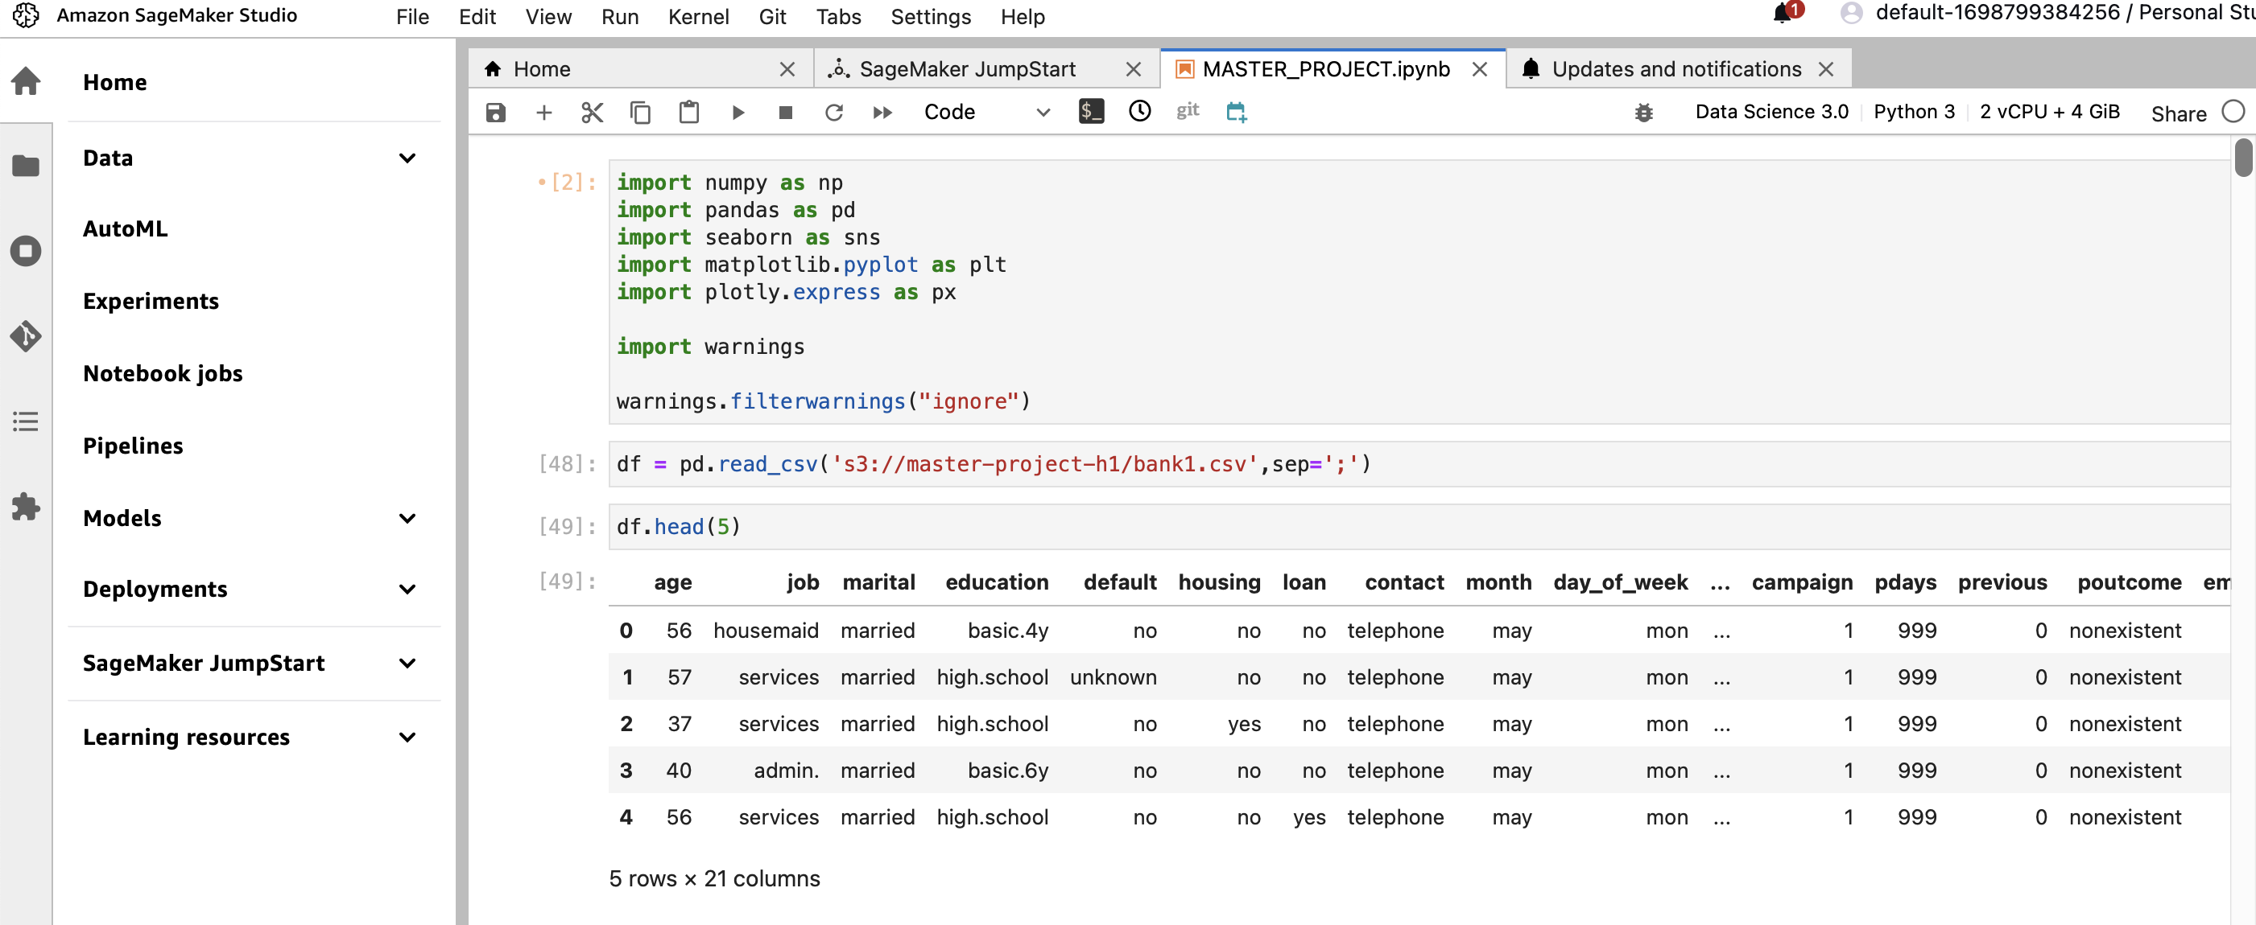
Sagemaker Studio Setup
Creating the Sagemaker domain and user.
Running the ML Algorithms on Sagemaker.

Slide 9
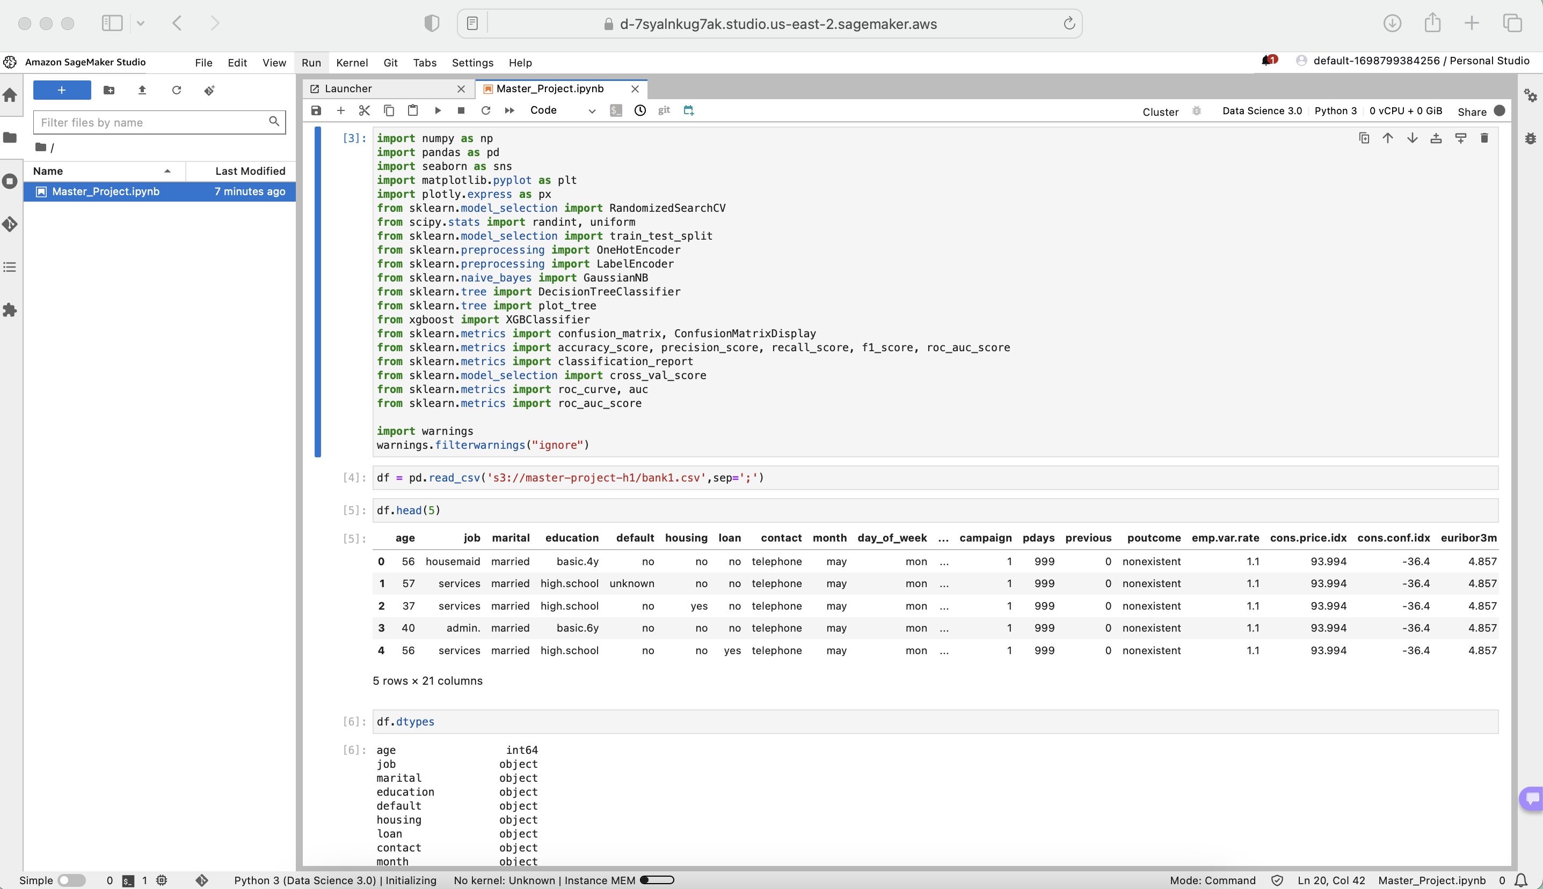
DATA LOADING
Importing the required Libraries and Loading the data.

Slide 10
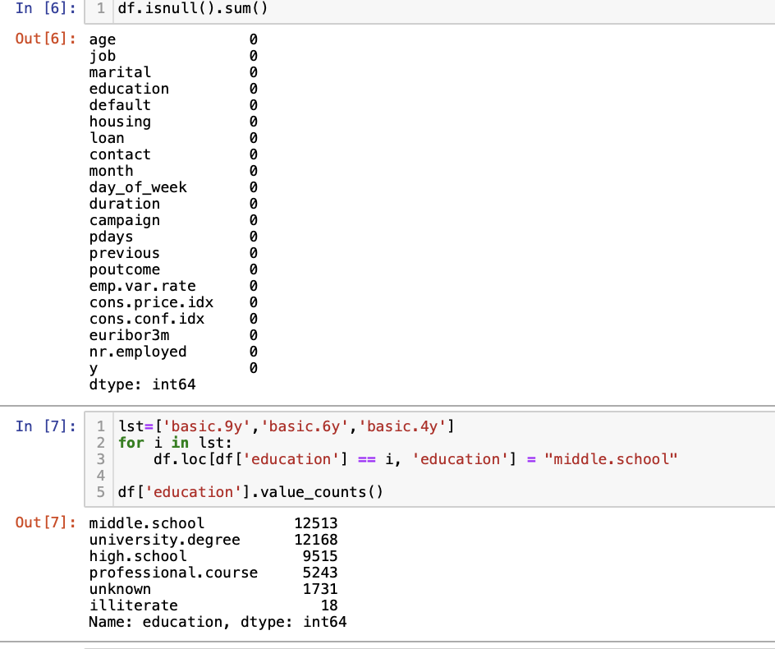
DATA PRE-PROCESSING
To have a cleaner dataset for our model to train I focused on data pre-processing.
I performed the following operations as part of pre-processing.
Null Check
Data Grouping
Datatype Casting

Slide 11
DATA VISUALIZATION
Performed Visualization of Data to understand the data better and visualize the different variables of the dataset.
Performed the following visualization:
Users by job type.
Users by marital status.
Users by education.
Users by contact type.
Users with housing Loans.
Users with Personal Loans.
Users by age.
Campaign Type.
Campaign Duration.

Slide 12
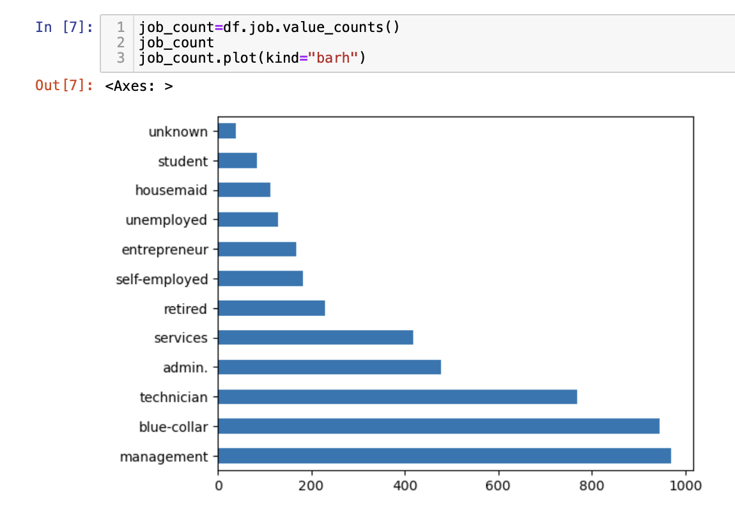
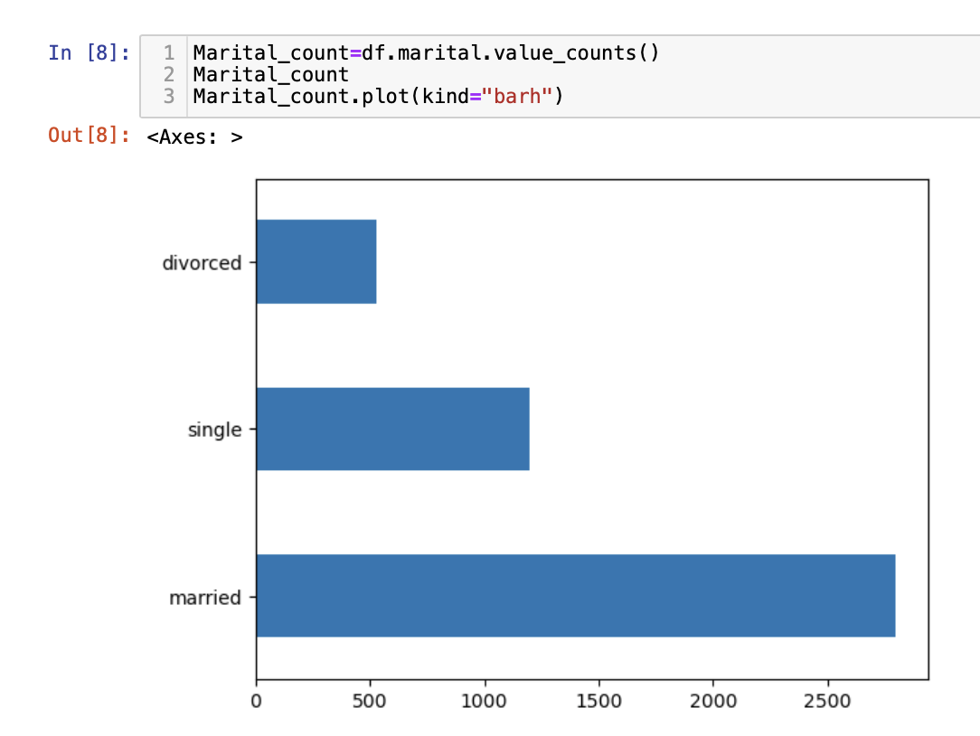
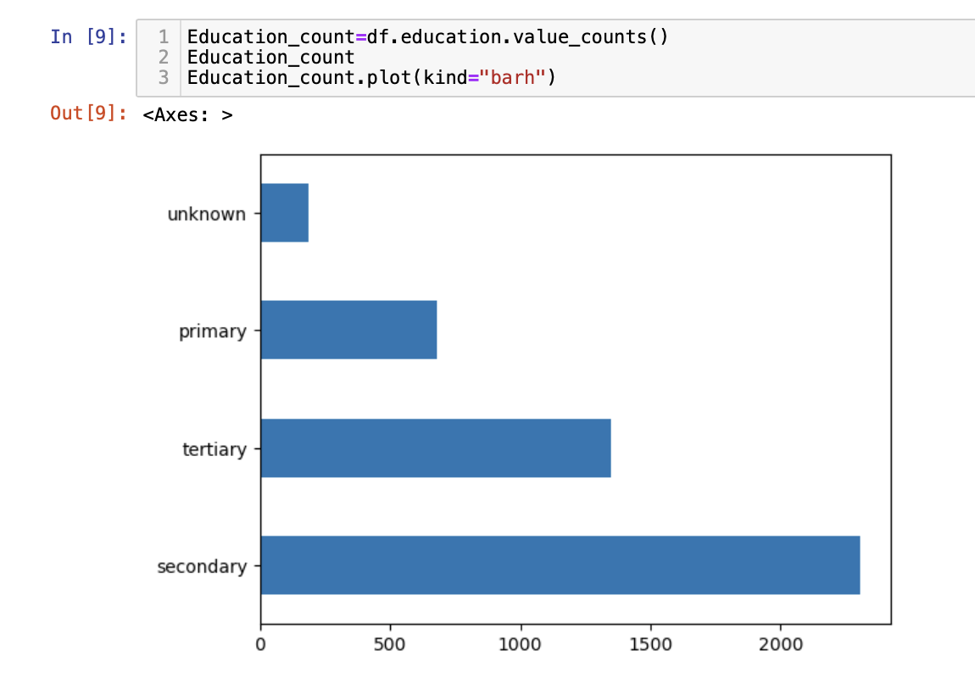
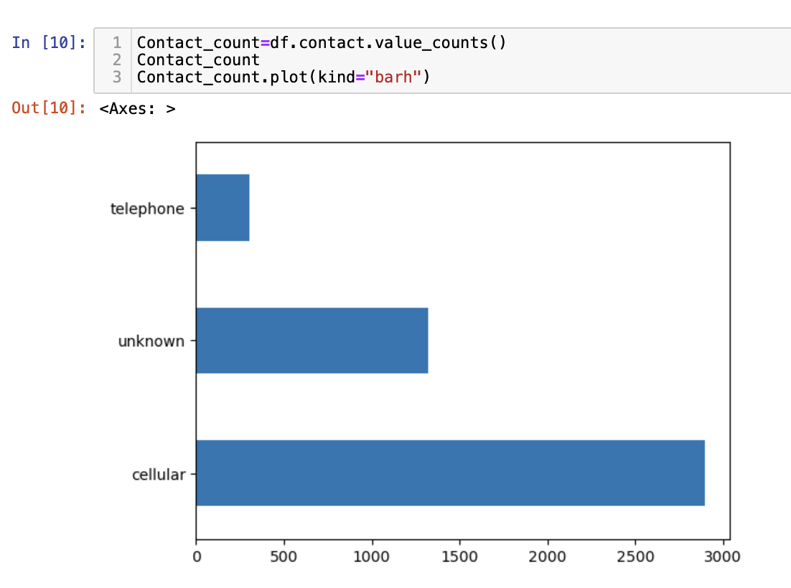
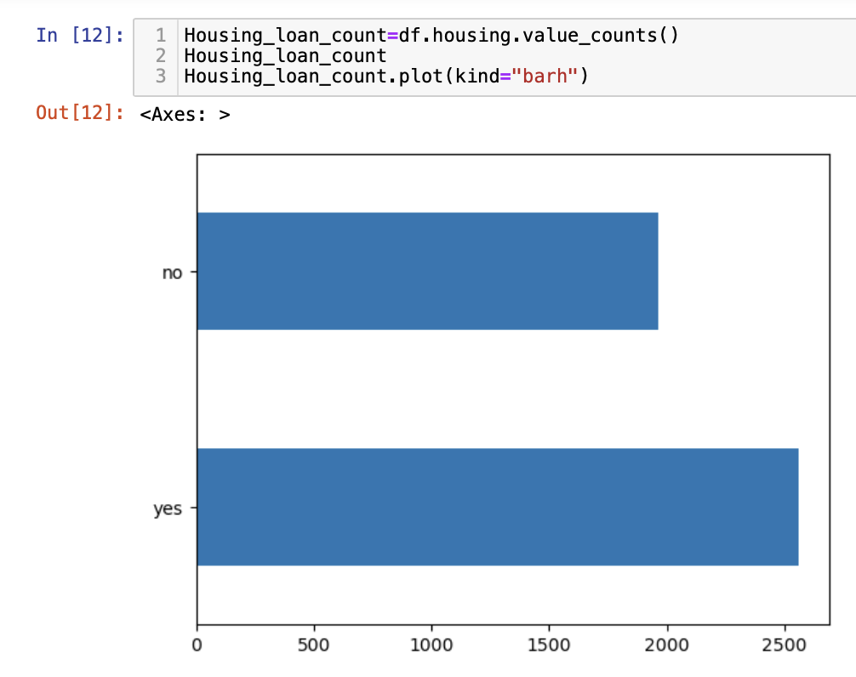
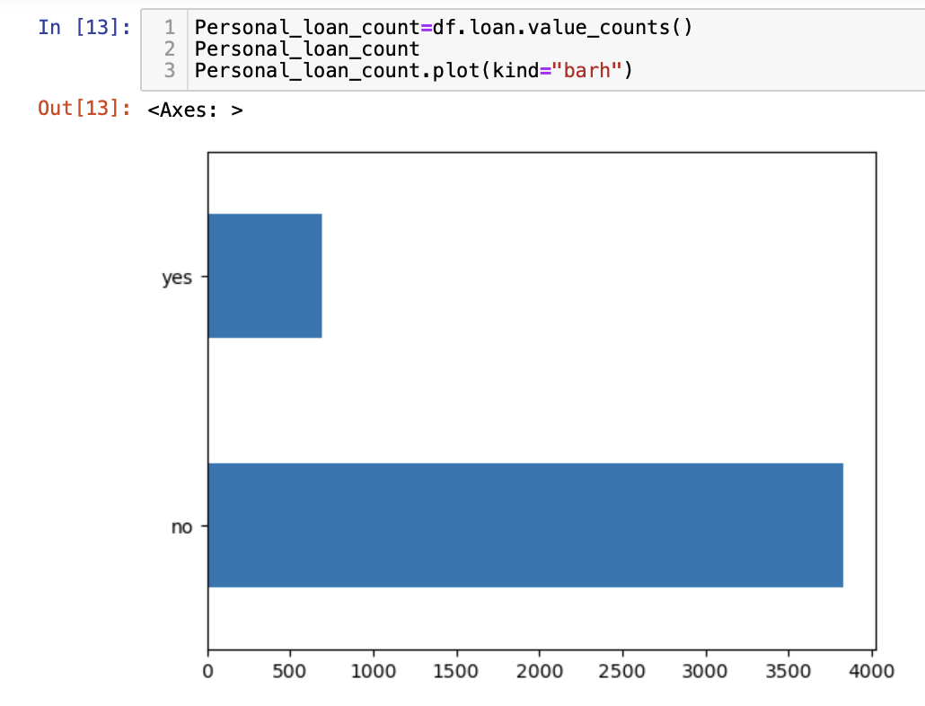
Visualization(Bar Plot)

Slide 13
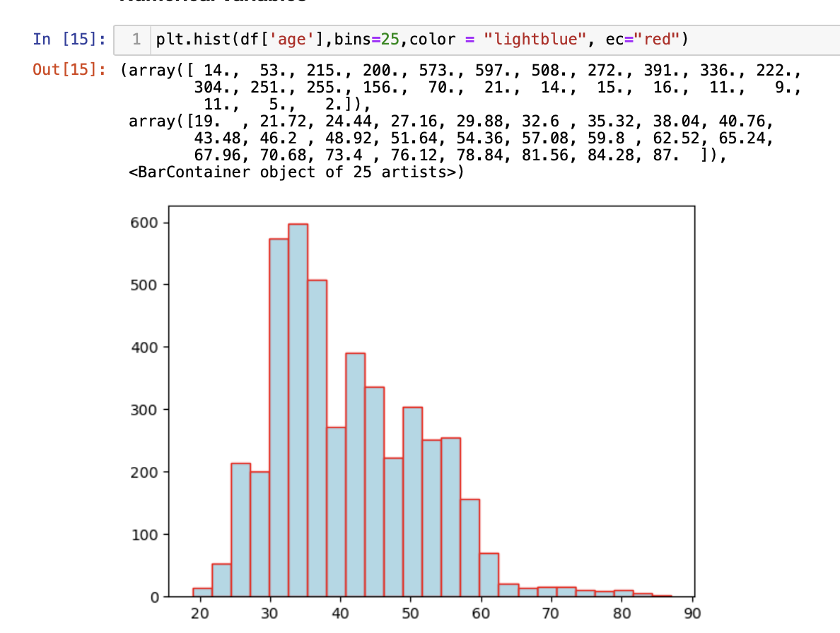
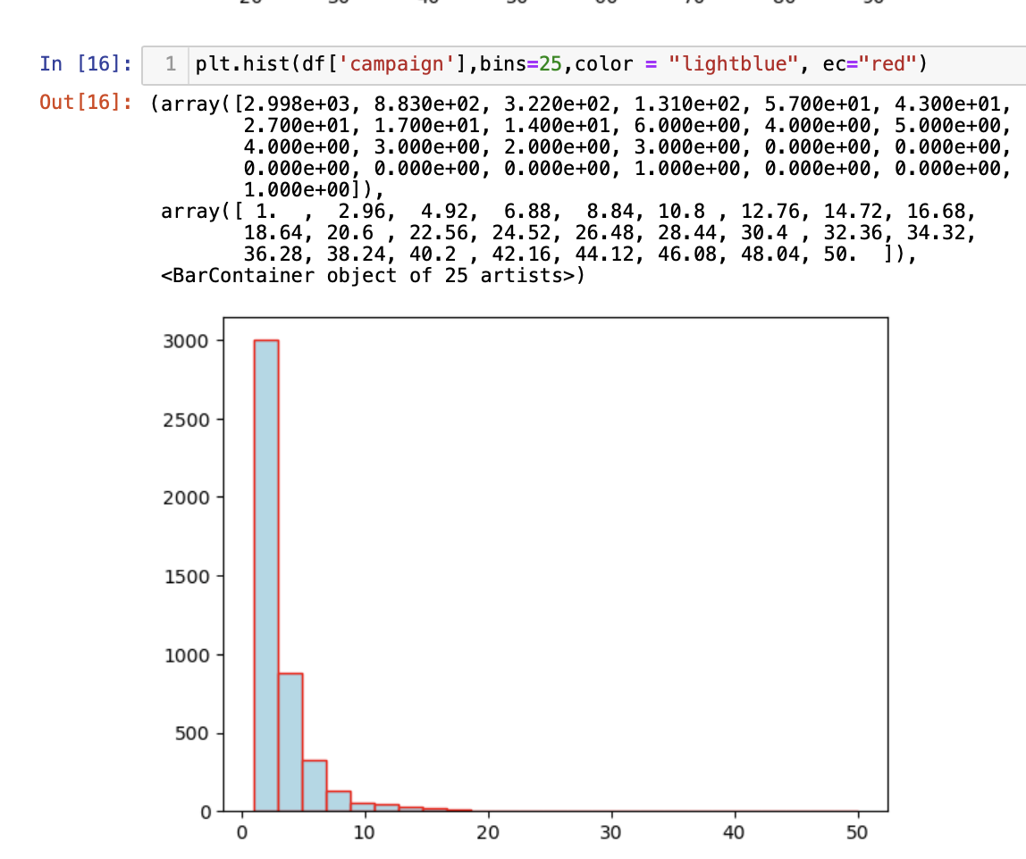
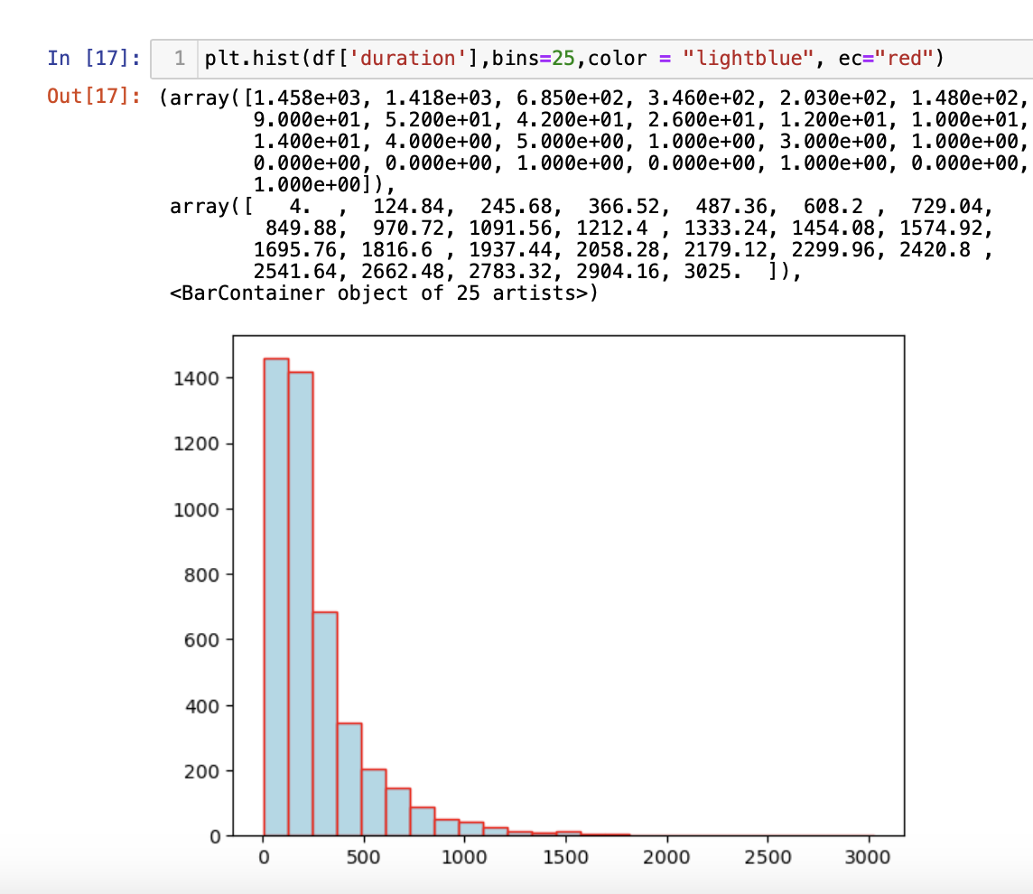
Visualization(Histogram)

Slide 14
FEATURE ENGINEERING
To better train our model I focused on Feature Engineering.
I performed the following operations as part of Feature Engineering.
Data Upsampling
One-hot encoding

Slide 15
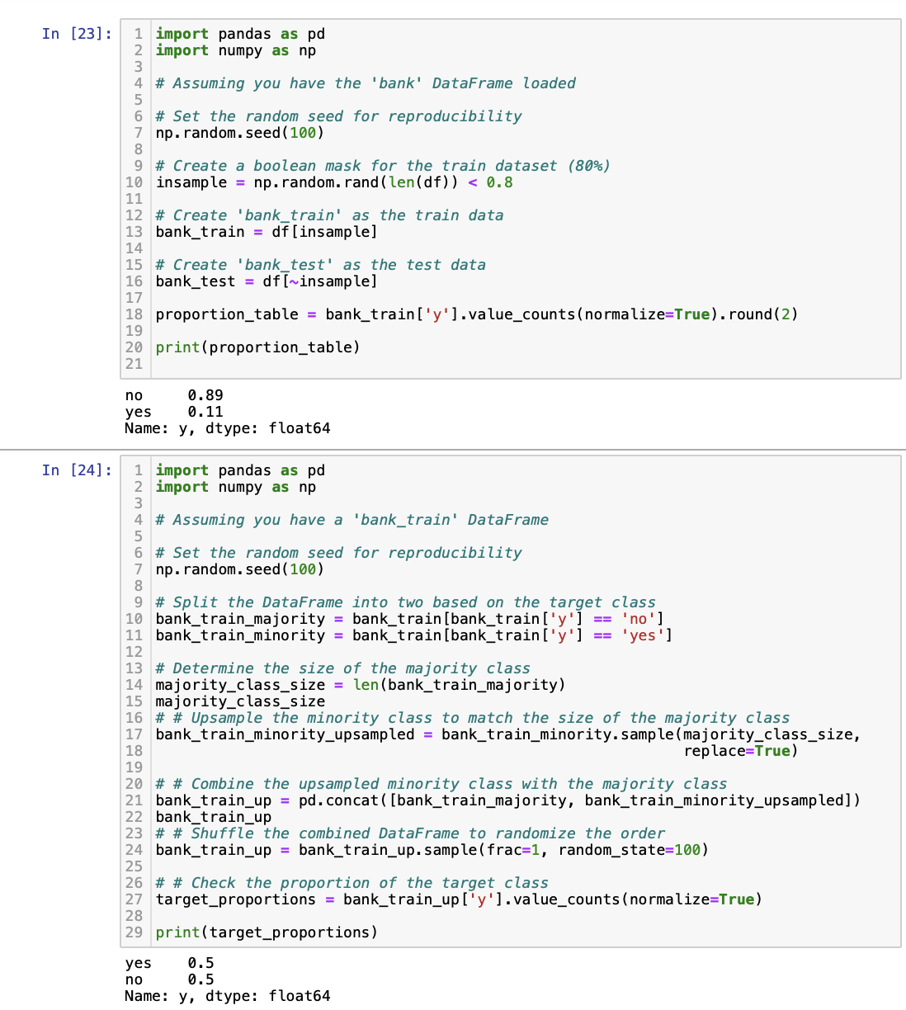
Data UpSampling
Performed data upsampling to handle imbalanced data.

Slide 16
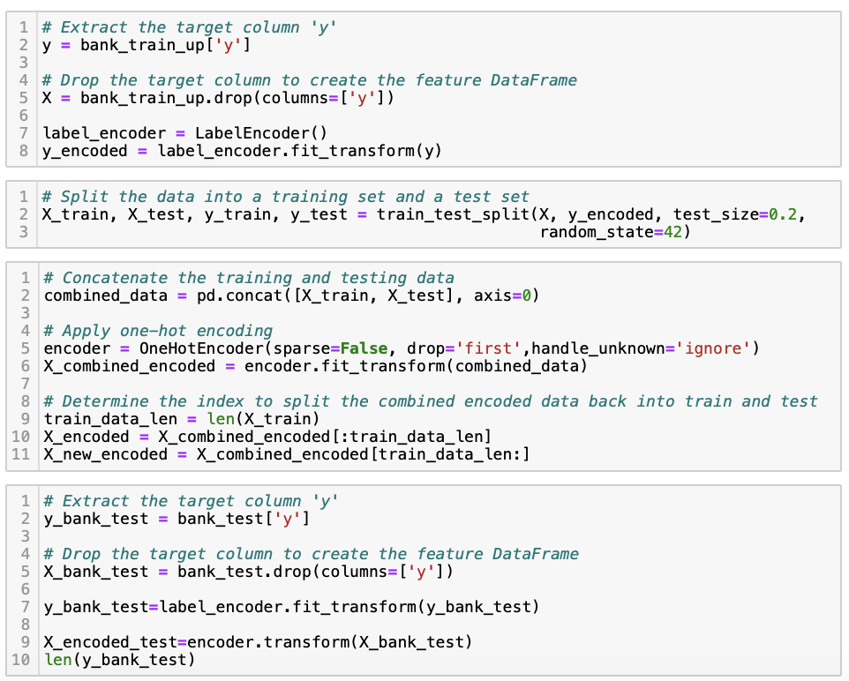
One-hot Encoding
Performed one-hot encoding to convert categorical data to numerical values

Slide 17
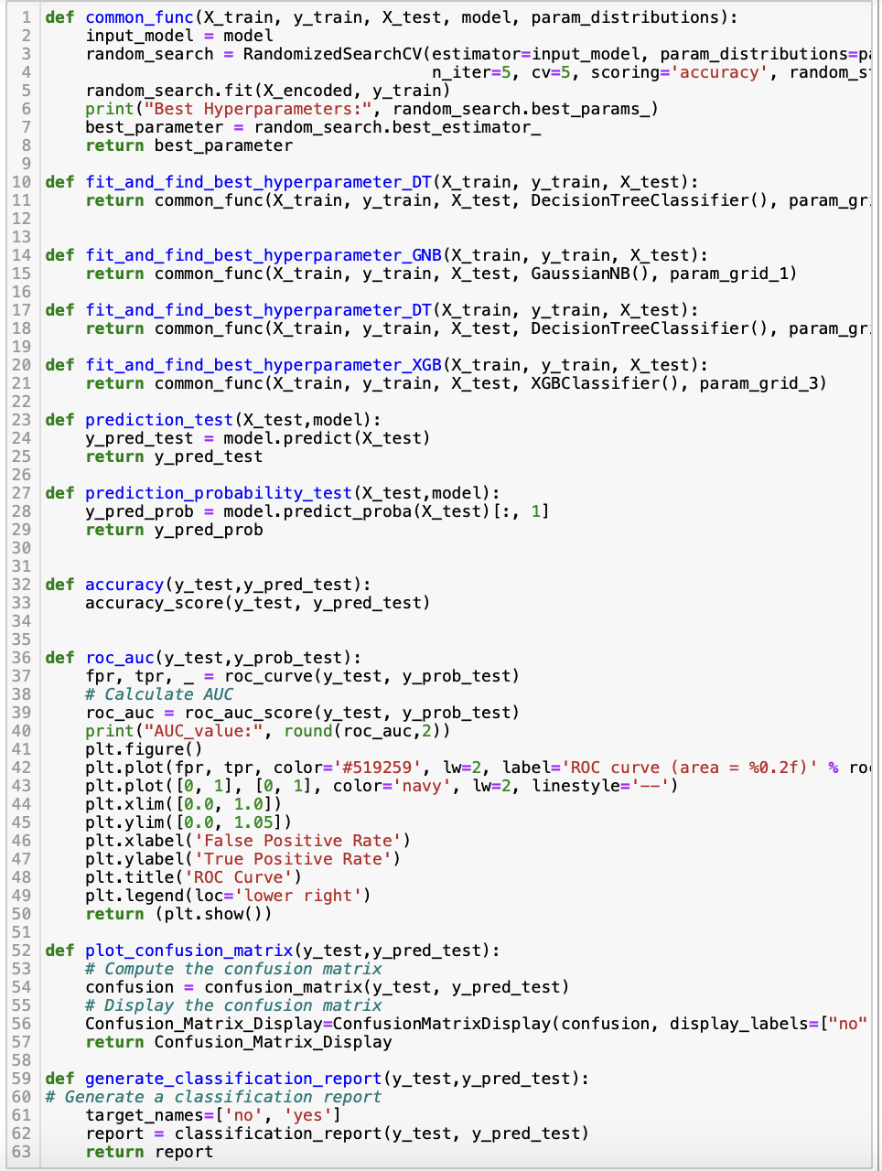
Common Functions
Built common functions to have a cleaner and reusable code
Fit_and_find_best_hyperparameter_GNB(), Fit_and_find_best_hyperparameter_DT(). Fit_and_find_best_hyperparameter_XGB() functions are used to find the best parameter and fit the specified model.
Prediction_test() function is used to find the predictions of test data
Accuracy() function used to find the accuracy of model.
Roc_auc curve is used to plot roc curve for the model
Plot_confusion_matrix() function is used to show confusion matrix of the model
Generate_classification_report() function is used to show cloassification report of the model

Slide 18
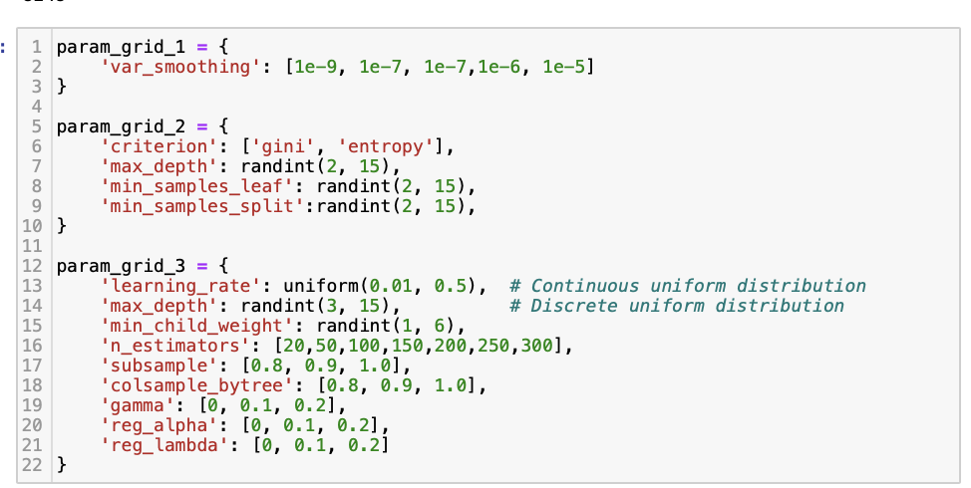
Hyperparameter Tuning
Assigned different values to the hyperparameters to find the best fit.
Param_grid_1 is the parameter grid for Gaussian Naïve bayes model which defines various hyperparameter values for var_smoothing.
Param_grid_2 is the parameter grid for Decision Trees model which defines various hyperparameter values for criterion,max_depth,min_sample_leaf and min_samples_split
Param_grid_3 is the parameter grid for XGBoost model which defines various hyperparameter values for learning_rate,max_depth,min_child_weight etc

Slide 19
ML MODELS
I trained my data with the following ML algorithms:
Gaussian Naïve Bayes
Decision Tree
XGBoost

Slide 20
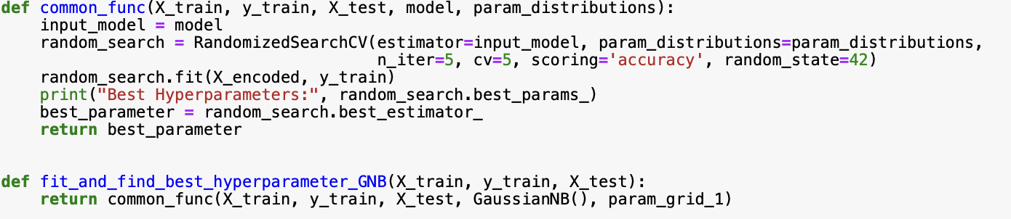
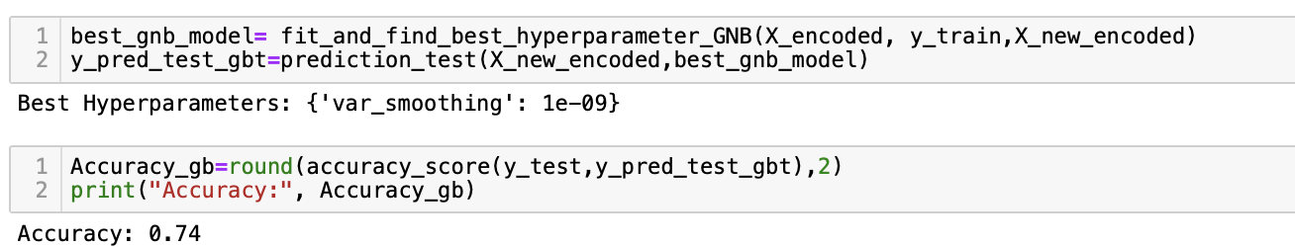
Gaussian Naïve Bayes (Training)
Training the model on the Gaussian Naïve Bayes Algorithm by calling the 'fit_and_find_best_hyperparameter_GNB’ function which finds the best hyperparameter and fits the model.

Slide 21
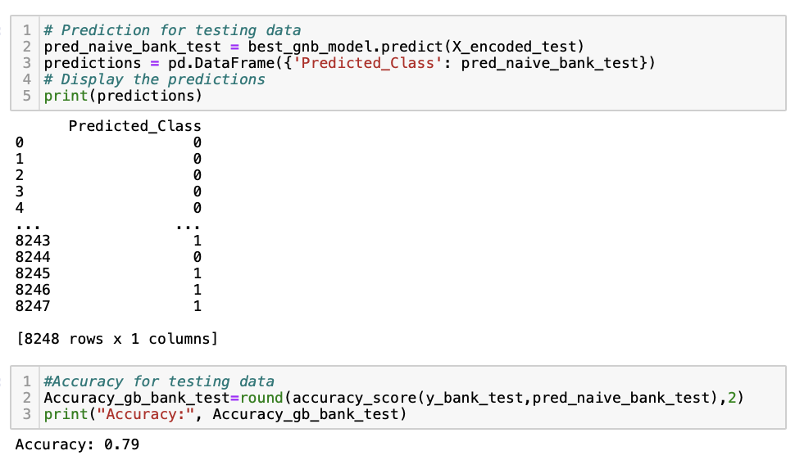
Gaussian Naïve Bayes (Testing)
Running the model on test data to find out predictions and accuracy.
Accuracy of the model on test data is observed as 0.79

Slide 22
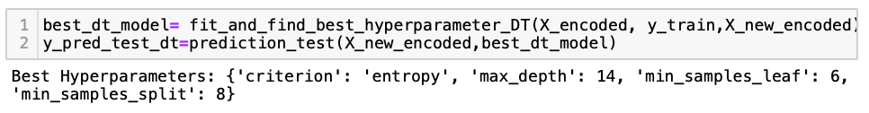
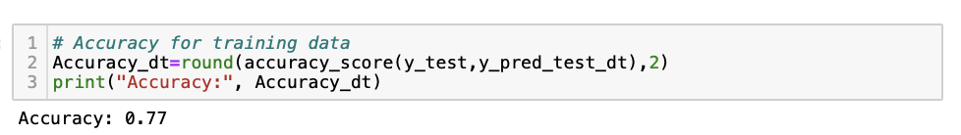
Decision Tree (Training)
Training the model on the Decision Tree Algorithm by calling the 'fit_and_find_best_hyperparameter_DT’ function which finds the best hyperparameter and fits the model.

Slide 23
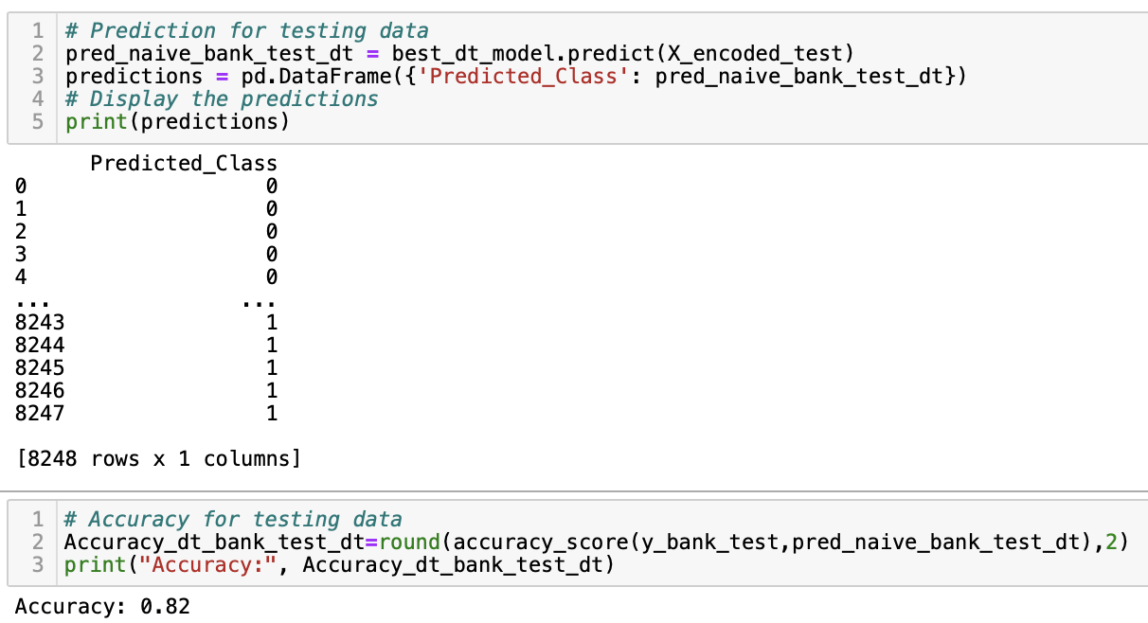
Decision Tree (Testing)
Running the model on test data to find out predictions and accuracy.
Accuracy of the model on test data is observed as 0.82

Slide 24
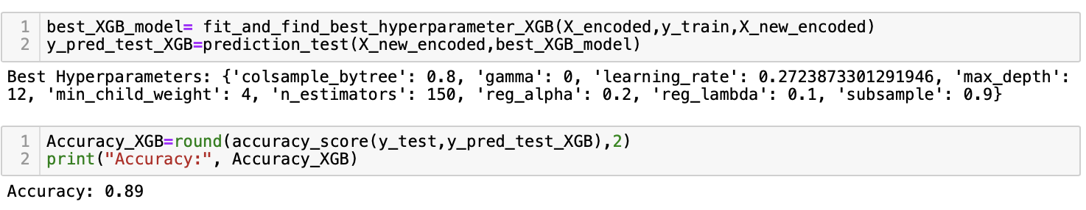
XGBoost (Training)
Training the model on the Decision Tree Algorithm by calling the 'fit_and_find_best_hyperparameter_XGB’ function which finds the best hyperparameter and fits the model.

Slide 25
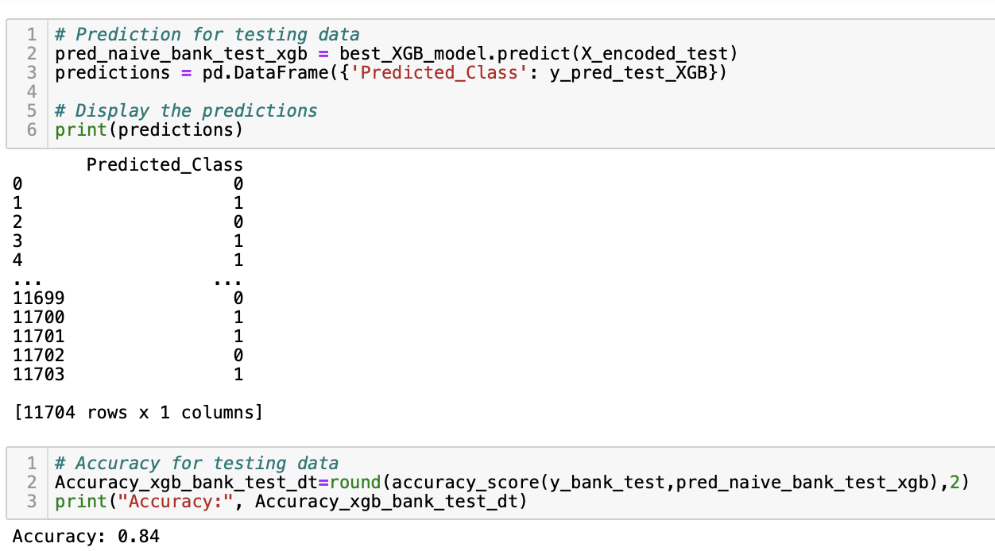
XGBoost (Testing)
Running the model on test data to find out predictions and accuracy.
Accuracy of the model on test data is observed as 0.84

Slide 26
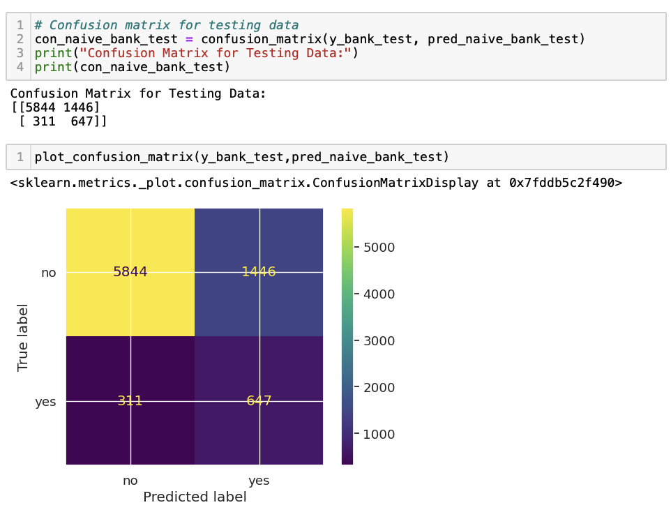
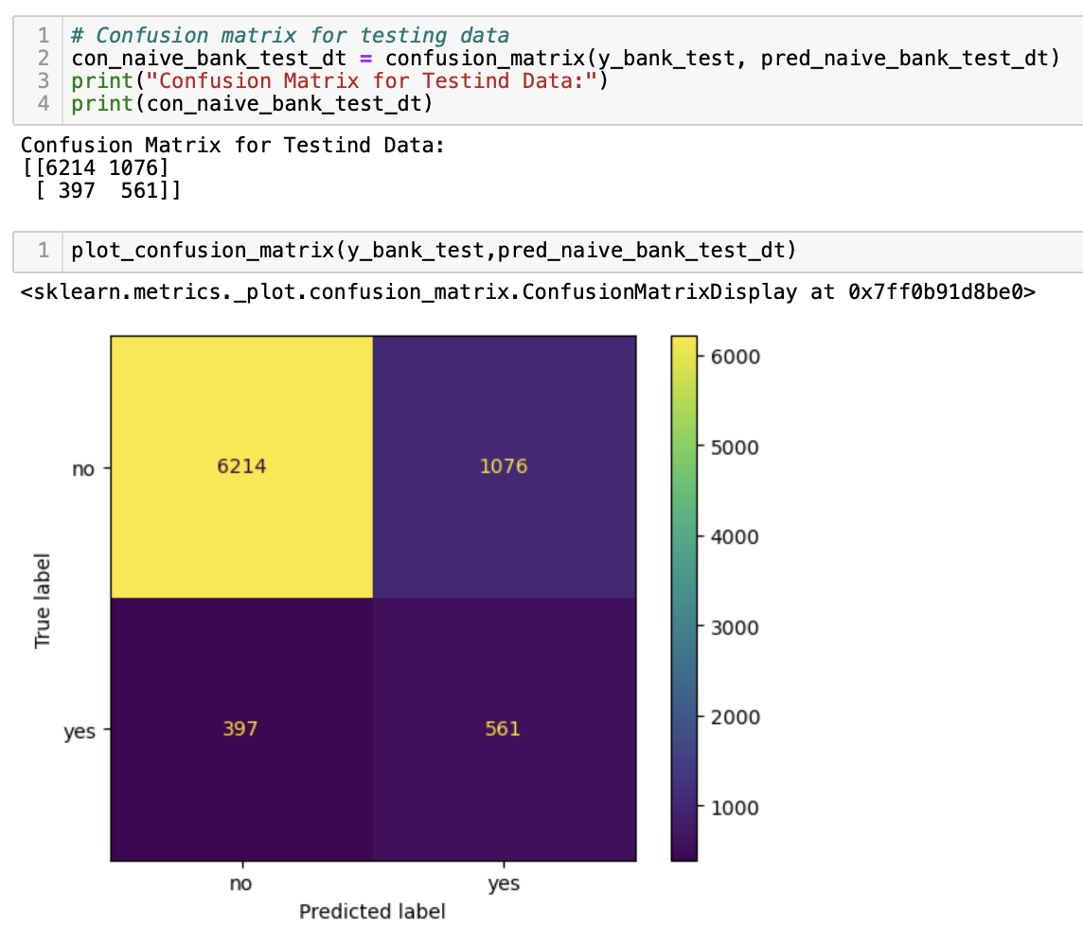
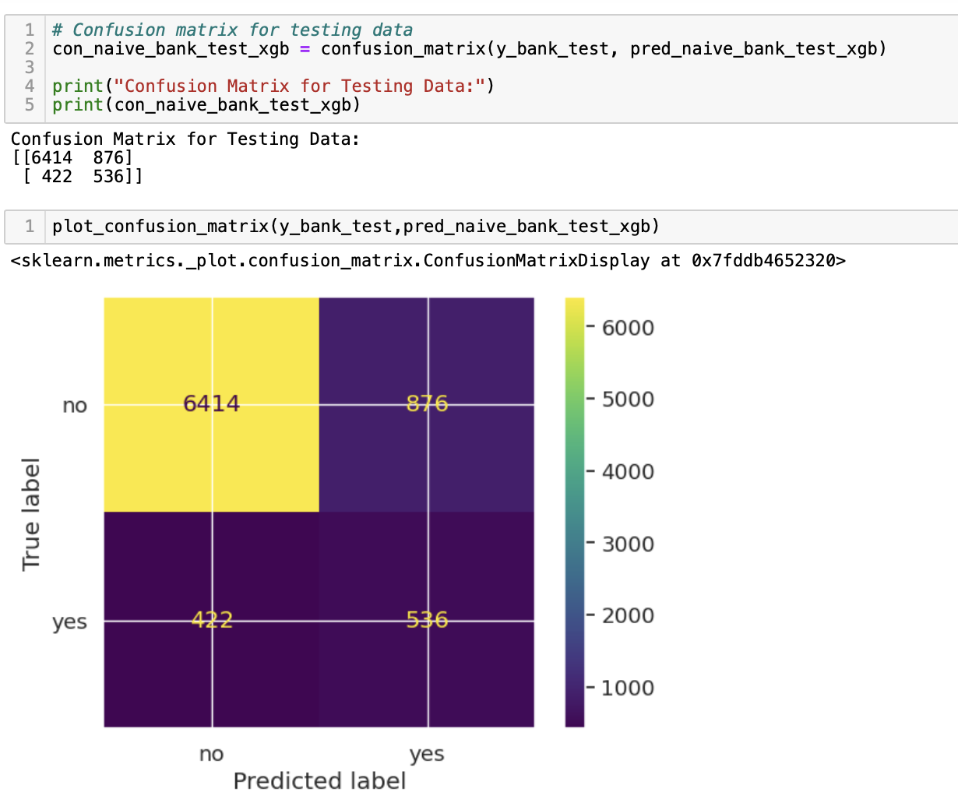
CONFUSION MATRIX
Gaussian Naïve Bayes
Decision Tree
XGBoost

Slide 27
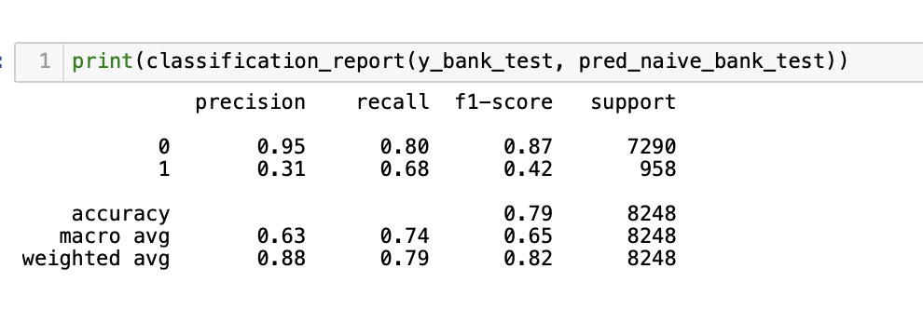
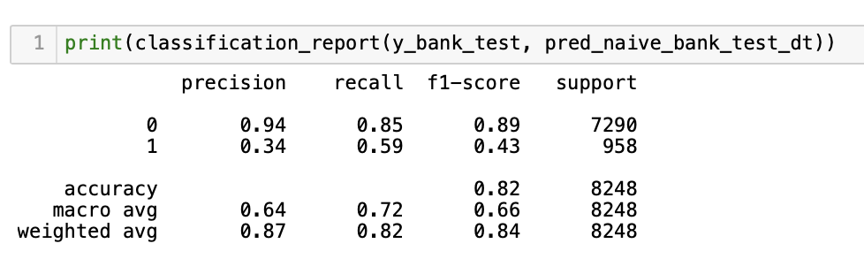
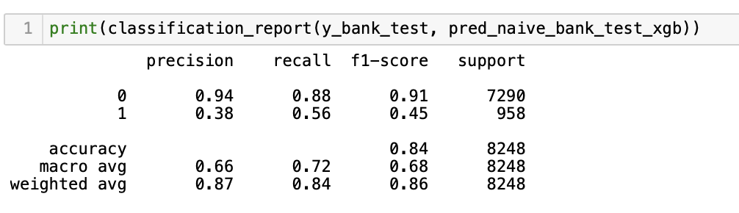
CLASSIFICATION REPORT
Gaussian Naïve Bayes
Decision Tree
XGBoost

Slide 28
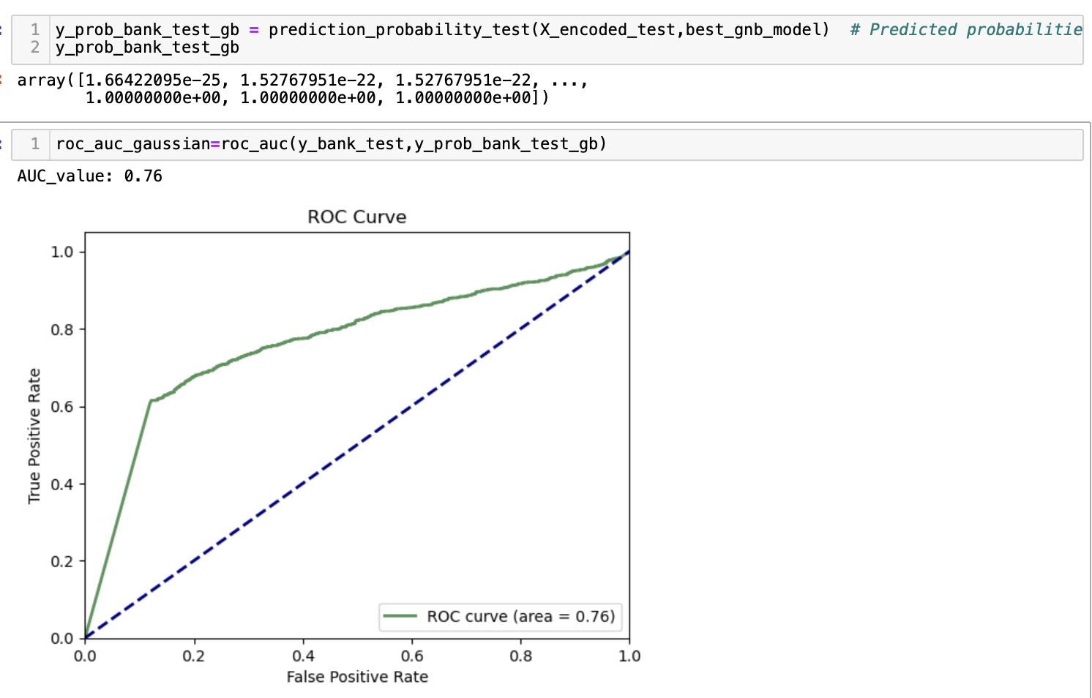
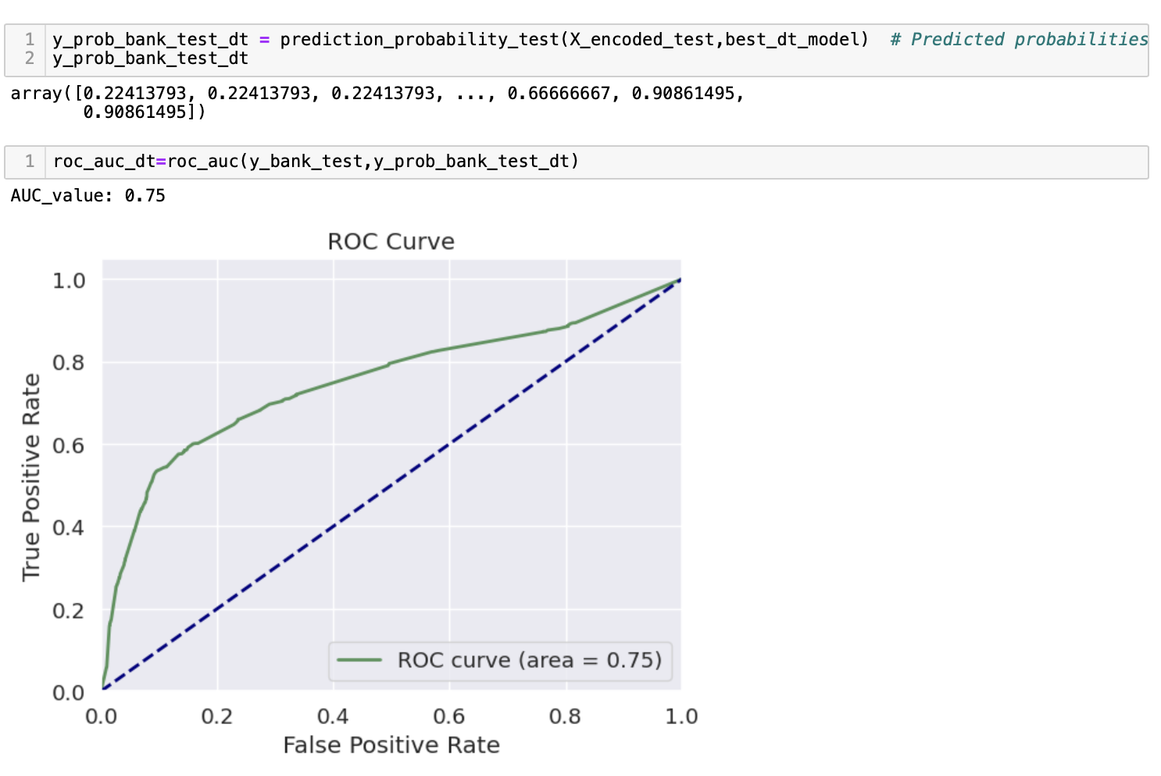
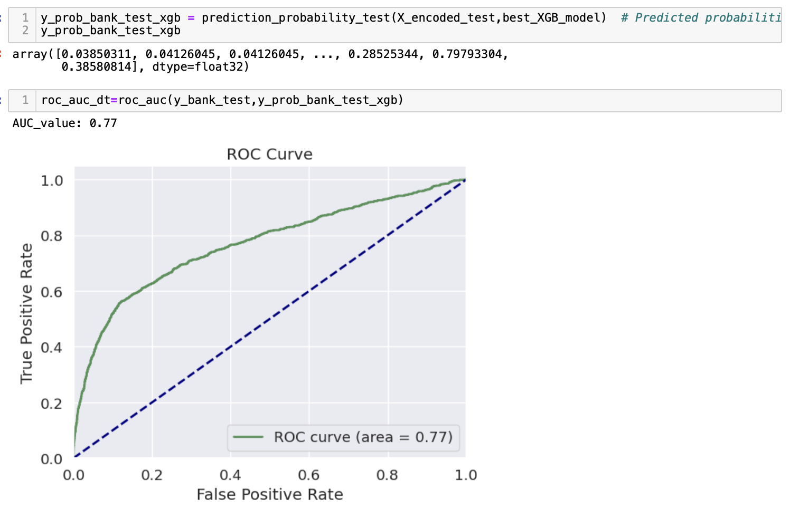
ROC & AUC CURVE
Gaussian Naïve Bayes
Decision Tree
XGBoost

Slide 29
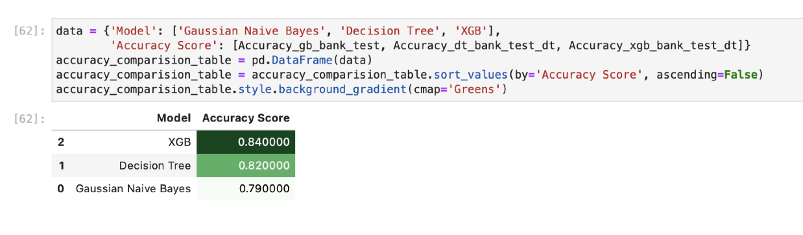
ACCURACY COMPARISION
We observe the accuracy of the three models as follows:
Gaussian Naïve Bayes - 0.79
Decision Trees – 0.82
XGB – 0.89
From the results obtained we observe that XGB accuracy is higher compared to Decision tree and Gaussian Naïve Bayes models for this dataset.

Slide 30
CONCLUSION
From our project we can effectively show the application of ML Algorithms in the Banking Sector.
We are able to successfully predict the likelihood of a specific customer signing up for a campaign with high accuracy.
Banks can use this project to efficiently target the Banking Users that have a higher probability to sign up for the term deposit campaign thus having a more effective, efficient and focus driven process.

Slide 31

Thank you

